Slide 1


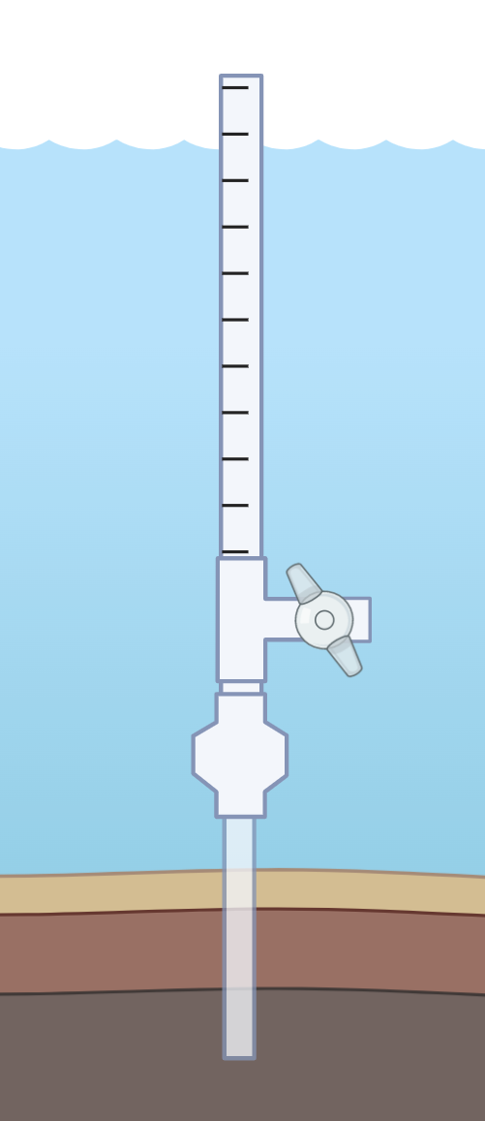
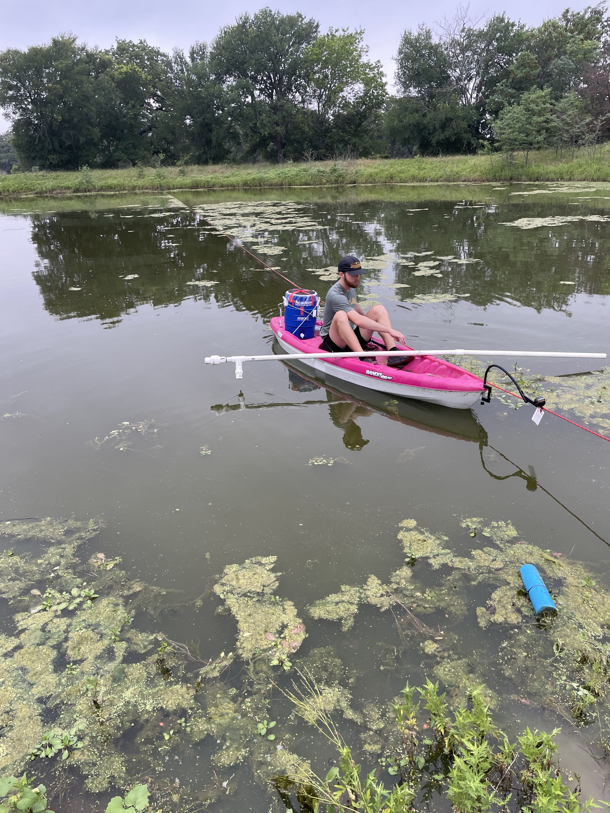
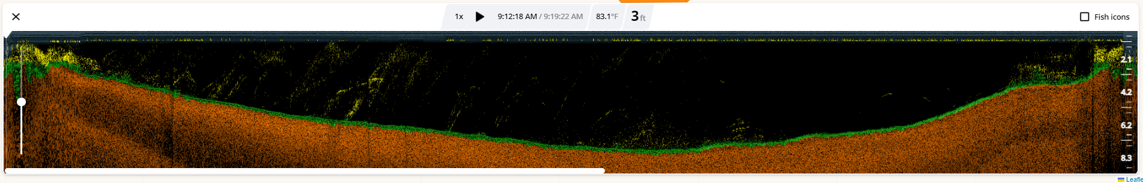
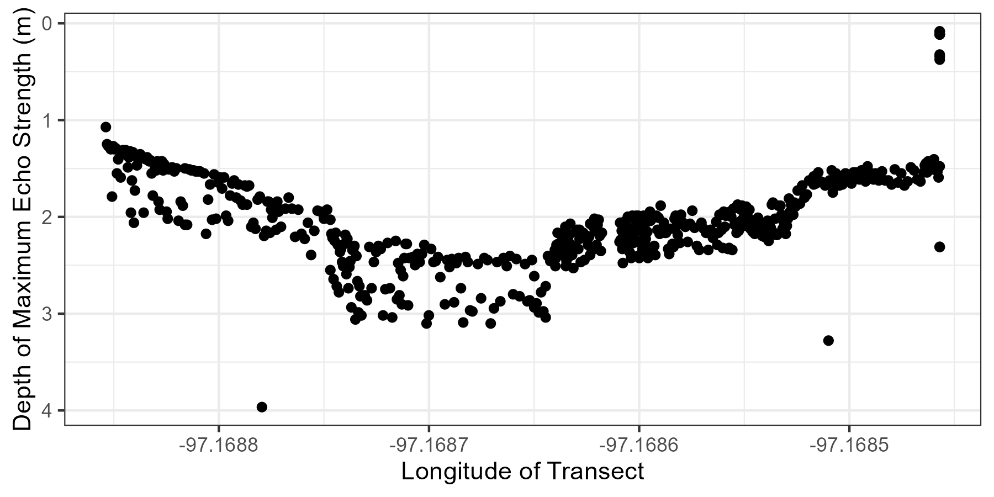
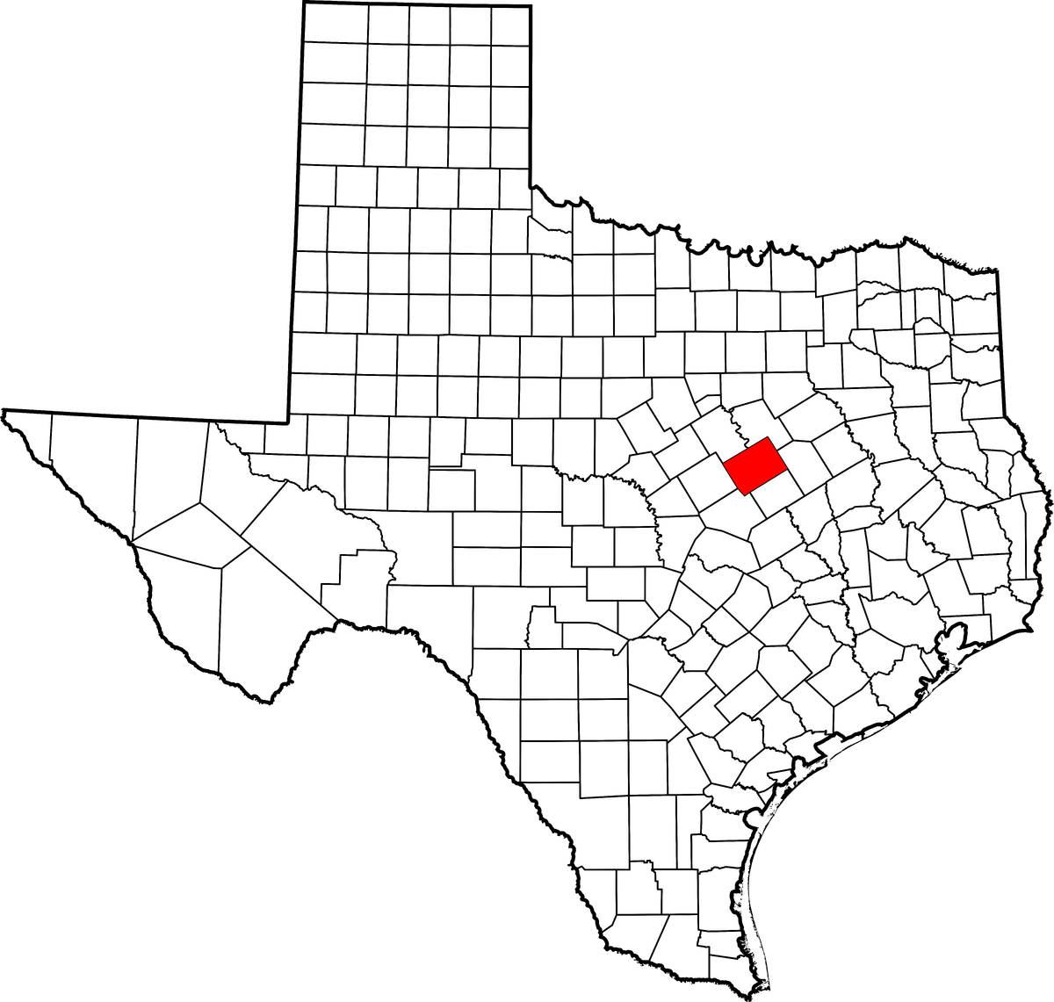
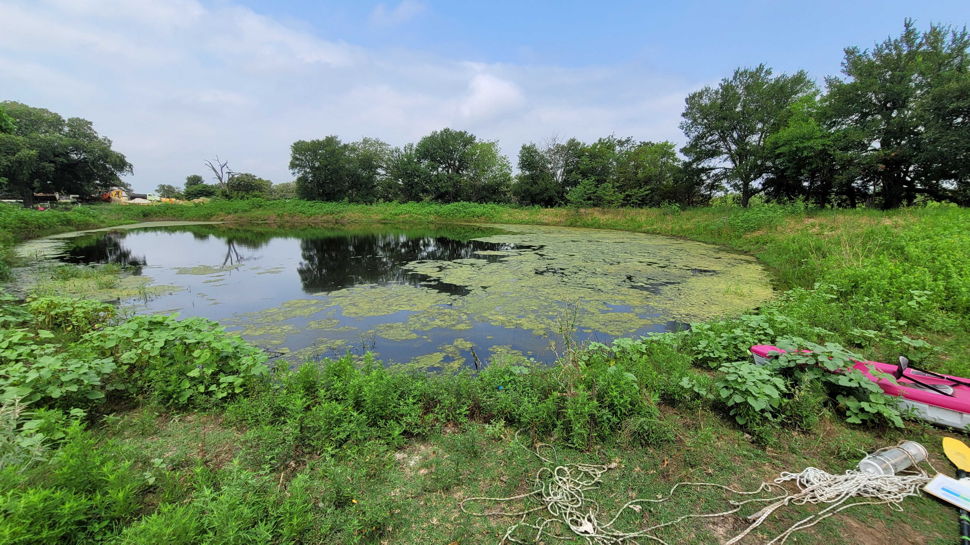
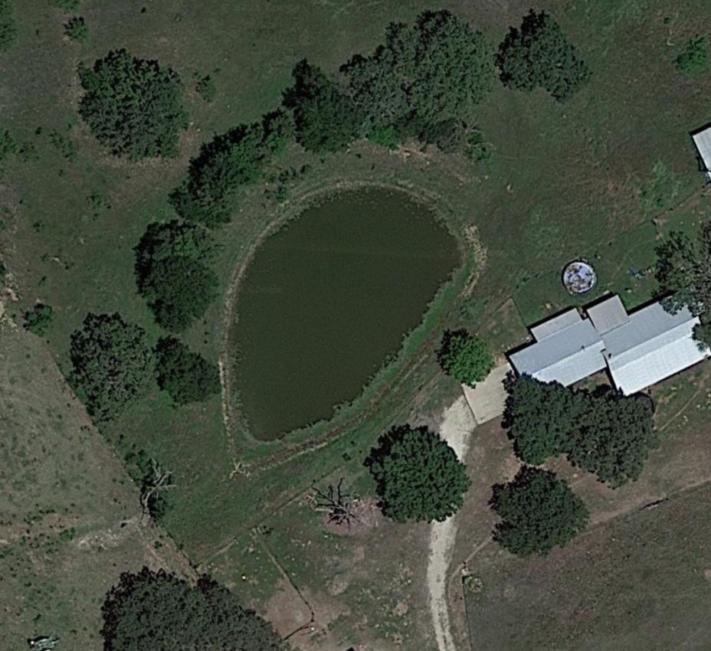
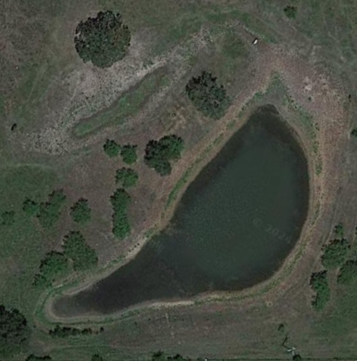
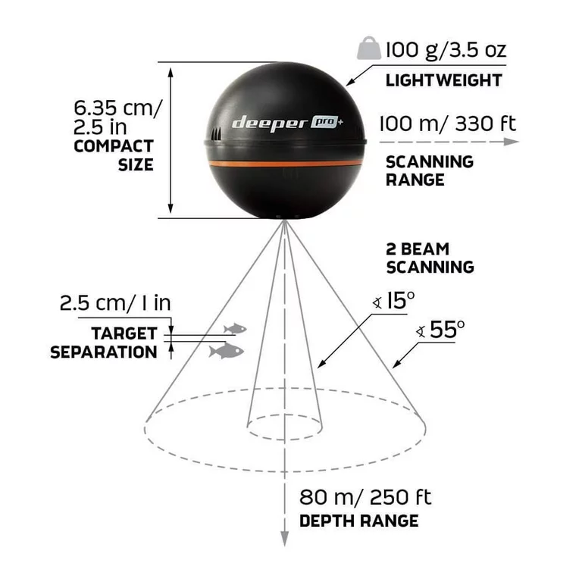

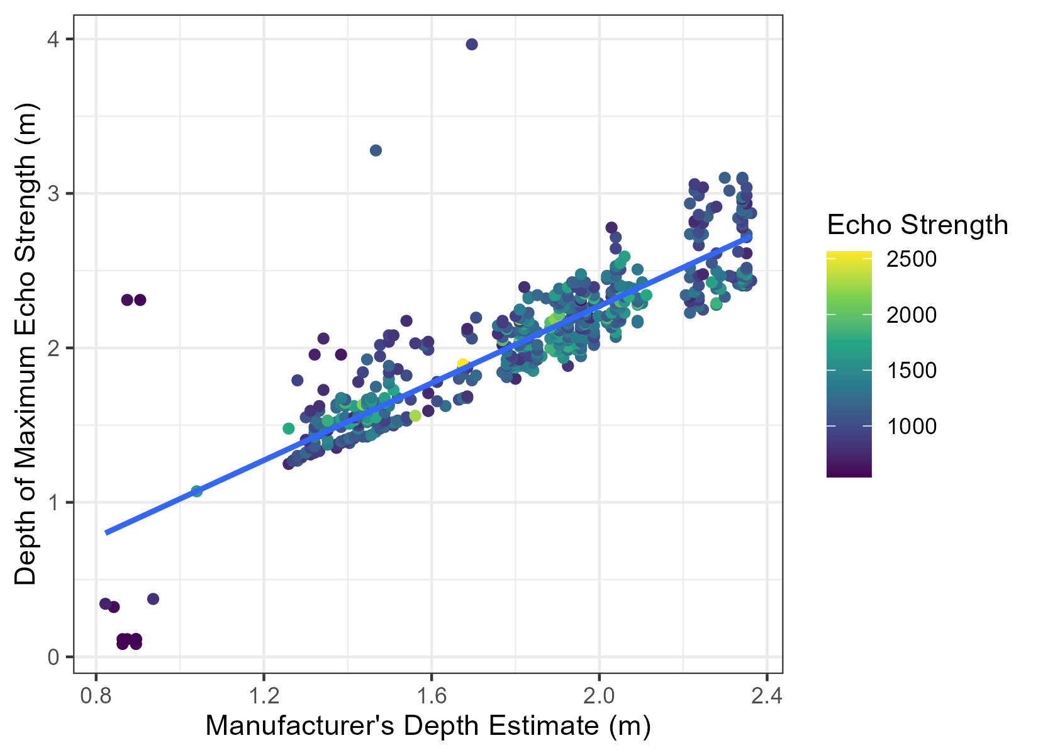
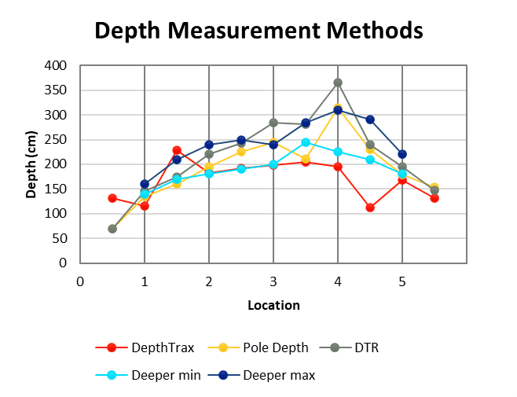
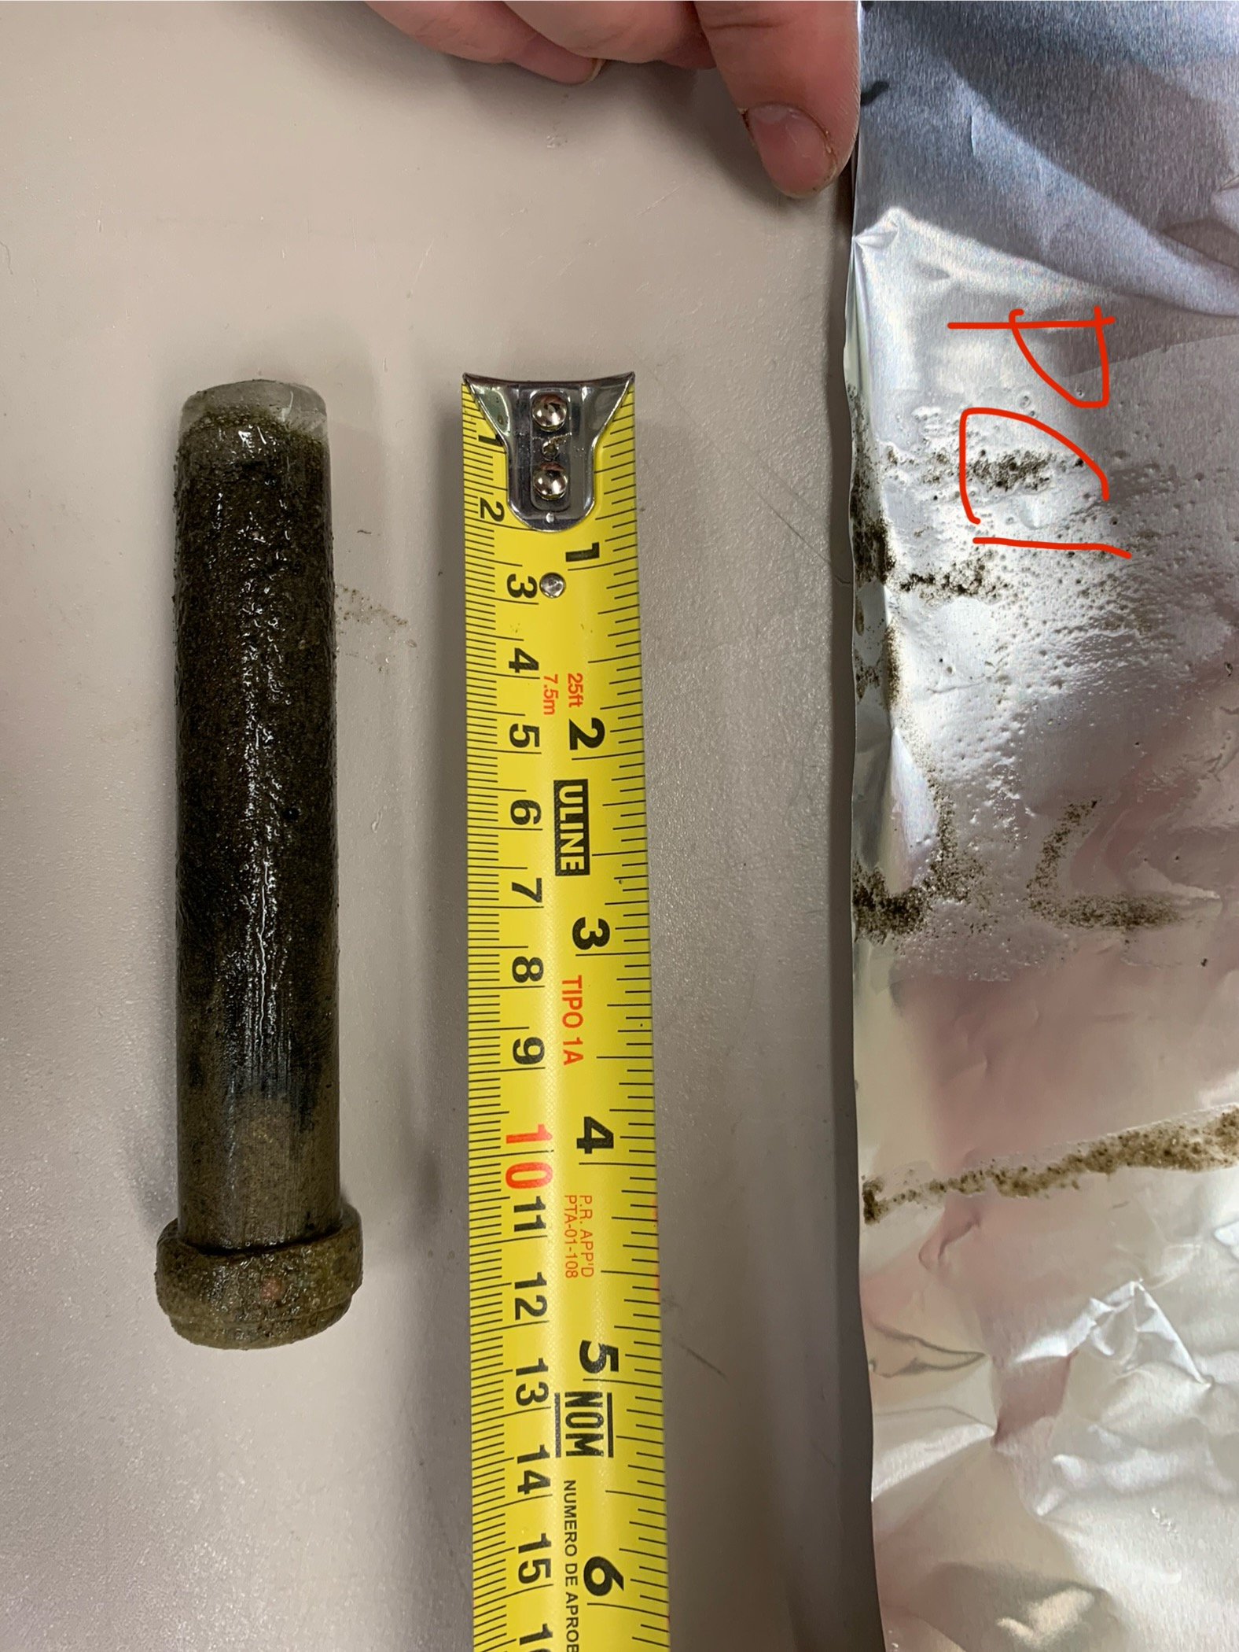
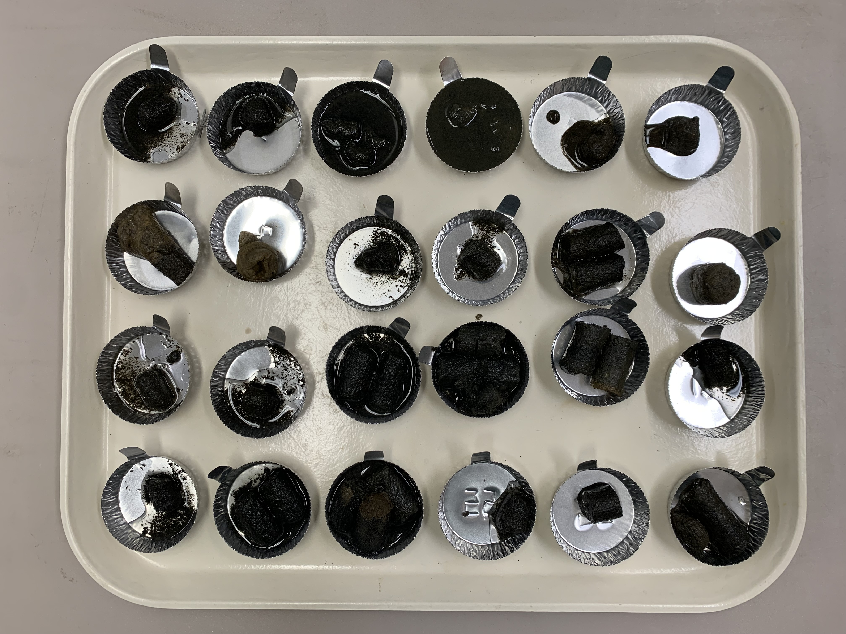
Rapid Three-Dimensional Surveys of Benthic Structure in Texas Ponds Informed by Single Beam Sonar
luke_day1@baylor.edu
s_powers@baylor.edu
https://sites.baylor.edu/powersresearchgroup/
1. Department of Biology and Center for Reservoir and Aquatic Systems Research (CRASR), Baylor University
Luke Day¹, Stephen M. Powers¹
Poster #57
Objectives
Methods
Results & Discussion
Rapidly generate maps of fine scale benthic structure in ponds using portable sonar device, and validate with point depth measurements
Compare spatially explicit single beam sonar data with sediment cores to determine if sonar can provide reliable 2D bathymetry along with estimates for depth of soft sediment, bulk density, macrophyte biomass, and organic matter content
0.5 m
1.0 m
1.5 m
2.0 m
Depth Markings
2.5 m
Figure 10. Deeper sonar data along a pond transect. Screenshot from the mobile application.
Background
Drain Valve
Figure 6. Transect rope, kayak, coring assembly, and Deeper assembly
Figure 1. Location of study ponds (McLennan county, Texas)
Figure 2. Wide angle of a pond study site
Check Valve
1
Core Tube
5
4
3
2
Figure 11. Deeper sonar data along a pond transect. Data are from downloaded sonar scans.
Figure 5. The sediment coring assembly
Figure 7. Pond coring locations, satellite view
Figure 3. Example transects for pond generated by Deeper sonar
Figure 4. Specifications of a castable sonar device, Deeper Pro+ 2
Continuous high frequency acoustic data was collected with Deeper Pro+ 2 sonar device along entire pond transect.
The HawkEye DepthTrax device provided independent sonar depth measurements at multiple points along the transect.
Pole measurements of water depth and depth to refusal were taken at the same points for comparison.
Sediment cores were collected at five points along the transect to evaluate bulk density and organic content of sediment across the pond.
Cores were frozen, then sectioned by standard depth ranges to distinguish vertical gradients in sediment composition.
Samples were dried at 55 ⁰C to calculate bulk density.
Samples were subsequently heated in a muffle furnace at 550 ⁰C to calculate organic matter loss on ignition.
Sediment organic matter composition, mineral properties, and benthic communities vary vertically and horizontally in aquatic ecosystems.
Public bathymetry maps are rarely available for small waterbodies such as ponds.
Three-dimensional surveys of the benthos could improve understanding of linkages between spatial structure and ecosystem function.
We are testing coring methods that allow us to collect many sediment cores rapidly in shallow water bodies, allowing three-dimensional characterization of benthic structure.
Figure 12. Correlation between Deeper’s estimate of water depth (proprietary algorithm) and our analysis of scan data.
Figure 13. Comparison of sonar and physical depth measurements
Bathymetry maps provide a more intuitive visualization of benthic structure compared to point measurements.
Proprietary algorithms may not provide sufficient analysis for thorough evaluation of sonar data. This necessitates development of open-source models to interpret raw sonar readings validated by independent measurements.
Our independent analysis of the acoustic data showed a strong correlation with other methods of measuring water depth.
Sonar may be useful for discerning variation in bulk density or organic content between sediment layers.
Further model testing across a larger number and diversity of pond types would provide insight on spatial heterogeneity of more complex benthic properties.
These acoustic methods can reveal vertical and horizontal discontinuities in pond sediment structure and habitat that may be relevant to understanding the sensitivity of carbon pools and fluxes to warming in ponds.
Selected Literature
Bučas et al. 2016. Assessment of a simple hydroacoustic system for the mapping of macrophytes in extremely shallow and turbid lagoon. Aquatic Botany
Buscombe et al. 2017. Compositional Signatures in Acoustic Backscatter Over Vegetated and Unvegetated Mixed Sand-Gravel Riverbeds. Journal of Geophysical Research: Earth Surface
Foster et al. 2011. Detecting end-member structural and biological elements of a coral reef using a single-beam acoustic ground discrimination system. International Journal of Remote Sensing
Helminen et al. 2019. Accuracy and Precision of Low-Cost Echosounder and Automated Data Processing Software for Habitat Mapping in a Large River. Diversity
Mizuno et al. 2018. Validation of a high-resolution acoustic imaging sonar method by estimating the biomass of submerged plants in shallow water. Ecological Informatics
Montereale et al. 2016. Evaluation of seabed mapping methods for fine-scale classification of extremely shallow benthic habitats – Application to the Venice Lagoon, Italy. Estuarine, Coastal and Shelf Science
Munday et al. 2013. Hydroacoustic mapping system for quantitative identification of aquatic macrophytes, substrate composition, and shallow water bathymetric surveying.
Quintino et al. 2010. Remote sensing of underwater vegetation using single-beam acoustics. Journal of Marine Sci
Torso et al. 2020. Variations in aquatic macrophyte phenology across three temperate lakes in the Coeur d’Alene Basin. Aquatic Botany
Figure 8. Frozen sediment core
Figure 9. Cores sectioned by depth, prepared for drying

